Slide 1
Digital Portfolio
STUDENT NAME: Jeevika A R
REGISTER NO AND NMID:2428B0316 And 03B877FE3FF0286B8E2431750AD94591
DEPARTMENT: B Sc Computer Science With Data Analytics
COLLEGE: KPR College of Arts Science And Research / Bharathiar University

Slide 2
PROJECT TITLE
Digital Portfolio for Leadership and Event Management System

Slide 3


AGENDA
Problem Statement
Project Overview
End Users
Tools and Technologies
Portfolio design and Layout
Features and Functionality
Results and Screenshots
Conclusion
Github Link
3/21/2024 Annual Review

Slide 4

PROBLEM STATEMENT
Leadership and event management often face challenges such as poor coordination, ineffective communication, and unclear responsibilities. Without strong leadership, events fail to achieve their objectives and result in participant dissatisfaction. This project addresses the need for a structured framework where leadership skills and systematic event management strategies come together to ensure smooth execution.

Slide 5

PROJECT OVERVIEW
The project focuses on developing leadership qualities such as decision-making, delegation, and problem-solving in the context of managing events. It highlights the importance of planning, organizing, executing, and evaluating events systematically. The work also emphasizes teamwork, communication strategies, and time management techniques that ensure events run successfully.

Slide 6

WHO ARE THE END USERS?
The primary users are student leaders, faculty members, and organizing committees who directly manage events. Participants, audiences, and attendees are indirect users who benefit from well-structured programs. External stakeholders such as sponsors, vendors, and guest speakers also depend on effective leadership and event management for smooth collaboration.

Slide 7

TOOLS AND TECHNIQUES
A variety of tools support leadership and event execution, including project management platforms like Trello and Asana for task tracking. Communication tools such as Microsoft Teams, Slack, and WhatsApp ensure proper coordination. Event scheduling and registration platforms like Eventbrite, Google Calendar, and Zoom help manage participation. Leadership models, decision-making strategies, and feedback systems also serve as key methodologies.

Slide 8
POTFOLIO DESIGN AND LAYOUT
The portfolio is designed to document every stage of event management with a focus on leadership contributions. It includes sections for planning strategies, team hierarchy, and task distribution. Layout features flowcharts, Gantt charts, and visual timelines to represent leadership decisions. It also showcases real event reports, photographs, and reflections from the organizing committee.
8

Slide 9
FEATURES AND FUNCTIONALITY
The system provides role allocation, task assignment, and progress tracking for every team member. It includes budgeting modules to manage event finances effectively. Leaders can monitor deadlines, send notifications, and ensure accountability. Feedback forms and reporting tools allow analysis of performance and event outcomes. The functionality ensures transparency, collaboration, and measurable results.

Slide 10
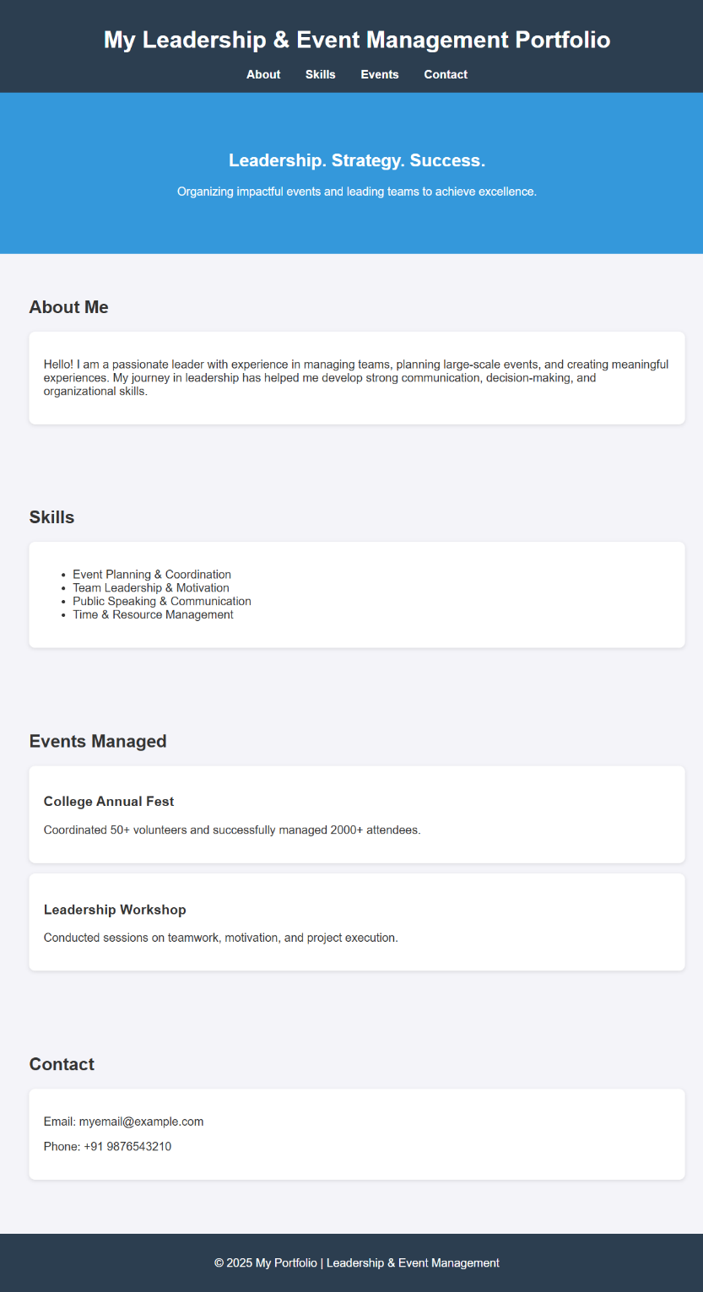

RESULTS AND SCREENSHOTS
The digital portfolio successfully showcases leadership qualities and event management activities in a structured format. Interactive features enhance navigation and make the portfolio more engaging. Students can now present their leadership roles, organizational skills, and event coordination achievements to recruiters and institutions in a professional way.
3/21/2024 Annual Review
10

Slide 11
CONCLUSION
Leadership combined with structured event management guarantees the success of programs. The project proves that teamwork, planning, and communication skills are enhanced through leadership-driven event handling. Strong leaders can motivate teams, resolve conflicts, and ensure goal achievement. This initiative provides practical knowledge and skills that are valuable for academic, professional, and personal growth.
11

Slide 12
GITHUB LINK
jeevika-2552.github.io https://jeevika-2552.github.io/Jeevika/

